Slide 1
Animated GIF in Product Documentation
Presenter: Madhusudan R
STC Regional Conference, Bangalore - August 31, 2019
1
© Nokia 2019

Slide 2
Agenda
1
Evolution of Animated GIF
2
Types of Animated GIF
3
Creating an Animated GIF
4
Sample GIFs
5
Benefits
2
© Nokia 2019

Slide 3
Evolution of Animated GIF
GIF Ideation
Animated GIF
Web Browser
Ruling Social Media
1987
1989
1995
Present
3
© Nokia 2019

Slide 4
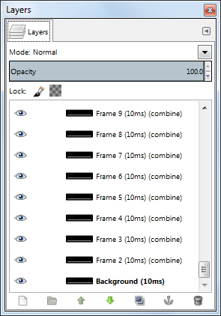
Dissecting Animated GIF
An Animated GIF is an image that is encoded using the graphics interchange format where it has multiple frames encoded into a single image file.
Multiple frames run in a sequence to create Animated GIF
4
© Nokia 2019

Slide 5
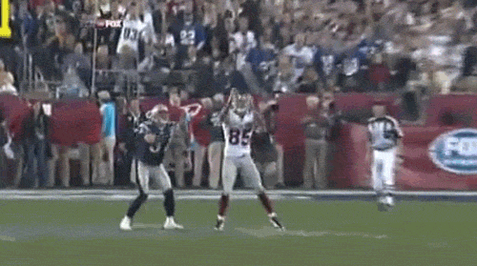
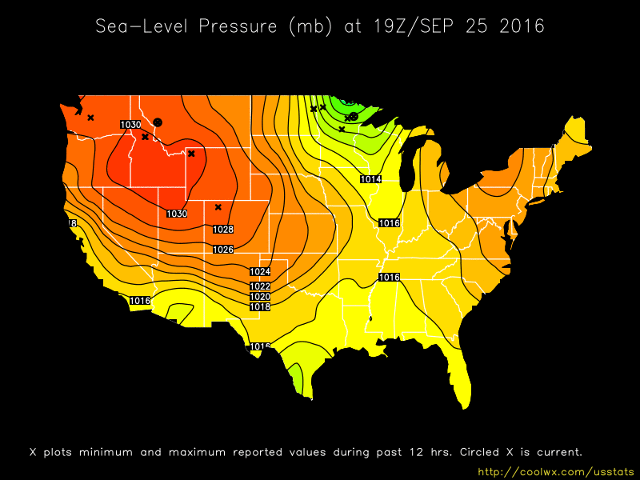
Types of Animated GIF
Reaction GIF
Reaction GIF
Cinemagraph GIF
Replay GIF
Cinemagraph GIF
Replay GIF
Perfect-Loop GIF
Perfect-Loop GIF
Technical GIF
Technical GIF
5
© Nokia 2019

Slide 6
Nokia’s Focus
Simulative
Simulate a task or a procedure
Technical GIF
Demonstrative
Conceptual explanation of a feature or a task
High-level walk though of a product
6
© Nokia 2019

Slide 7
Creating an Animated GIF
Capture
Generate
Publish
Identify a use case.
Capture the images in a sequence.
Open a GIF Editor.
Import the images.
Set animation.
Generate GIF.
Insert the GIF into the XML file.
Generate the HTML output.
Test the GIF in a Web browser.
© Nokia 2017
7
© Nokia 2019

Slide 8
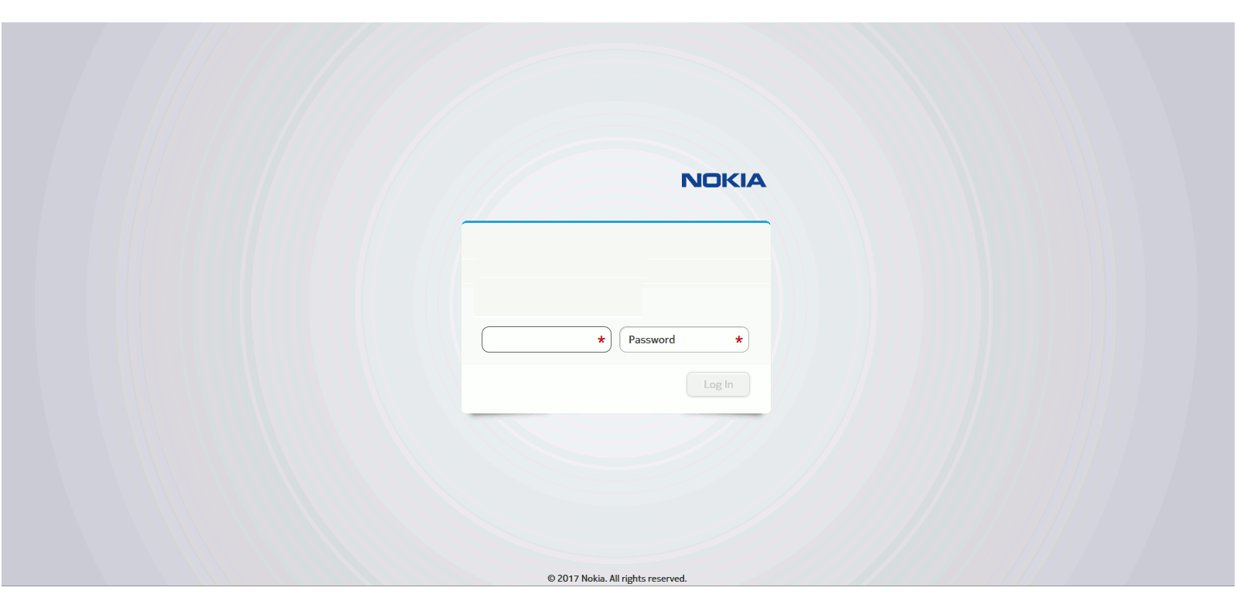
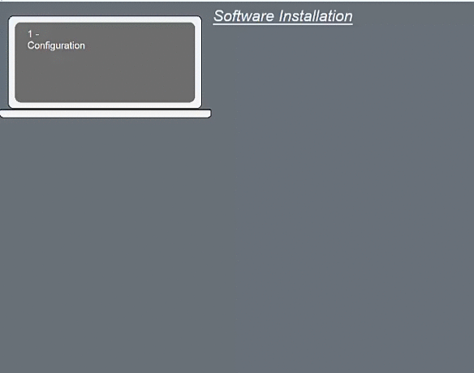
Sample Animated GIFs
8
© Nokia 2019

Slide 9
Benefits
Reduces Complexity
Lightweight &
Portable
Works in any
Web browser
Reduces Cost &
Effort
Easy to Create
Enhances UX
Easy to Maintain
9
© Nokia 2019

Slide 10
General Guidelines
GIFs act as a supplementary documentation
Human attention span of 8 seconds must be kept in mind while creating Animated GIFs
Browser extensions for controlling the Animated GIFs
10
© Nokia 2019

