Slide 1
SAP Enable Now Web Assistant content strategy
Unnikrishnan G and Prasad Hariharan, SAP
August, 2019

Slide 2
Agenda
Strategy for implementing SAP Enable Now Web Assistant
Traditional doc vs Online help
Online Help vs Context help
Enable Now Web Assistant
Content landscape
Training
In-app content standard
Context help content strategy
Sample screens of SAP Enable Now Web Assistant

Slide 3
Traditional documentation vs Online help
Traditional documentation | Online help
Guides in printed format | PDF guides followed by HTML topics
Manual search for content | Online search for content
Costly and time consuming to maintain | Comparatively economic and easy to maintain
Cumbersome to access | Easy to access

Slide 4
Online help vs Contextual help
Online help | Contextual help
PDF guides or HTML documents | Available in pop-ups/hotspots
Massive guides | Specific help available in context
Search and retrievability are cumbersome | Information can be easily retrieved
Time-consuming search | Instant search
May or may not impact support volumes | High probability to reduce the support call volume

Slide 5
Context sensitive help (in-app help)
Context-sensitive help is a kind of online help that is obtained from a specific point in the state of the software, providing help for the situation that is associated with that state.
Can be accessed by hovering the mouse over an object, clicking an object or a button, clicking the ? Icon or entering the F1 key.
Can be displayed through the tool tip, GUI widget or walkthroughs, wizard, embedded help, and inline instruction.

Slide 6
What is SAP Enable Now
SAP Enable Now: A product suite that allows authors to collaboratively create, manage, and deliver content using contextual online help, formal training, and informal learning. The product allows customers not only to modify the content provided by SAP but also to deliver their own content for customized applications if they buy the license.
Web Assistant: The front end component of the Enable Now framework that is embedded in some of the web-based SAP applications that displays help content as an overlay screen on top of the current screen in real-time. The content is available in three modes – context help, guided tours, and tutorials. Customers can buy the license for Enable Now (with the back end component – Enable Now Manager) if they want to modify the content or create own content.

Slide 7
Content landscape overview (from Central UA)
Context-sensitive help
Guided tours
Getting started tutorial
Task tutorial
Web Assistant
consume
Help Portal
Enable Now server
publish
DITA CMS
Enable Now CMS
Enable Now CMS
SAP
Customer/Partner
UA
SME (whoever has the right expertise) and recording/production service

Slide 8
SAP training options for customers
Public training: https://training.sap.com/search?q=Enable+NOw&filters%5Bcountry%5D%5BUnited+States+of+America%5D=on&filters%5Bcountry%5D%5BCanada%5D=on
Learning Hub: https://training.sap.com/learninghub
SEN10, SEN20, SEN30, SEN100 – recorded trainings
Professional edition – professional users
Business edition – $250 p.a. – general users
Discovery edition – 14-day trial period
Service for training with customer – This is typically how customers do it today

Slide 9
Why a standard for in-app help?
In-app help at the fingertips leads to happy users and helps drive feature adoption and renewals
Provides great impact on customer experience and call driver volume
Consistent look and feel across applications
No need of a rigid guideline within the org but a common framework is important

Slide 10
Contextual help content strategy
Developing in-app content for a solution for the first time.
Which UI elements to document?
How many call drivers need to be documented?
What workflows should be captured?
How the in-app content will co-exist with the other forms of help?
Developing in-app content for new features – aligned with the SAP Ariba feature doc strategy.
Document only the new UI elements
Document only the new workflows
Relevant call drivers and FAQs
A comprehensive doc strategy (in-app content is the lead-in help with standard documentation)
SME contributed tutorials

Slide 11
Supplier Experience – launch in-app help
Click the question mark icon to display the Enable Now carousel

Slide 12
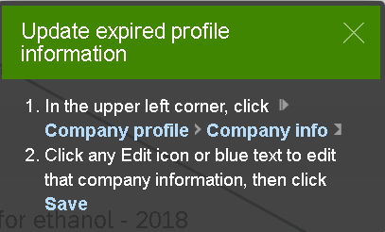
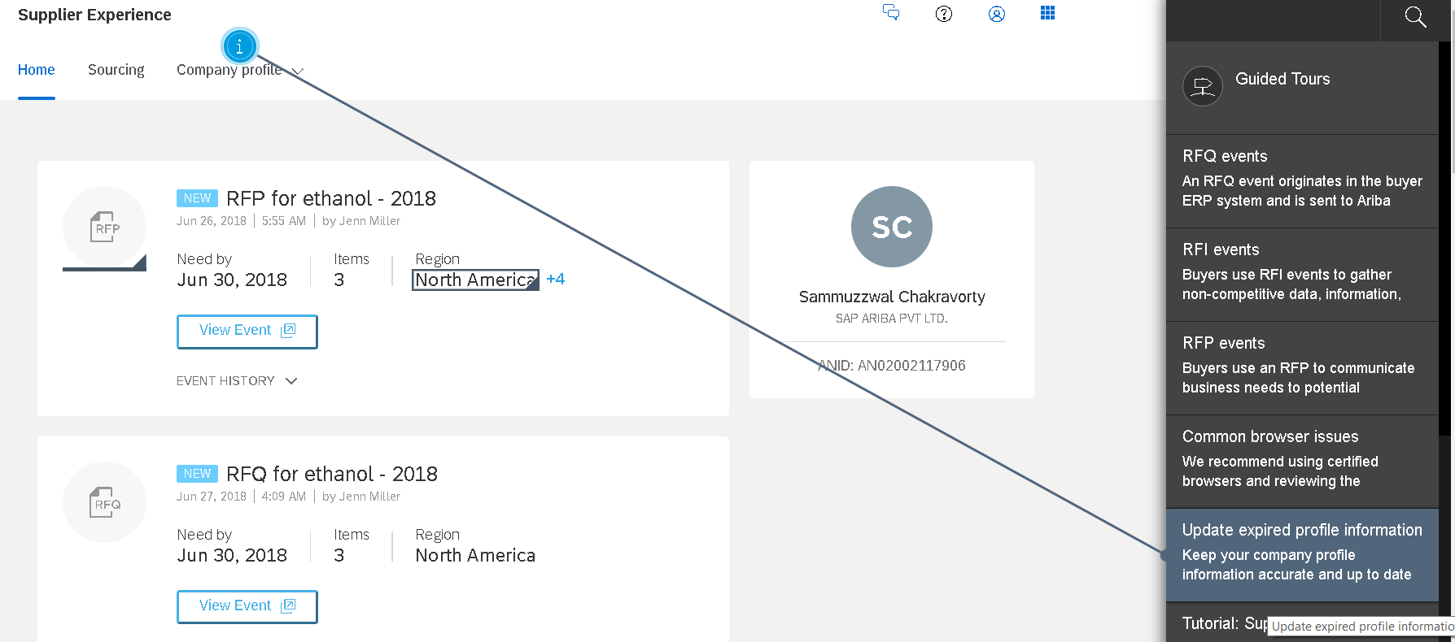
Supplier Experience – carousel
Guided Tour
Web assistant Help in the carousel
Context Help in a hotspot
Context Help
Tutorials

Slide 13
SAP Enable Now Web Assistant help carousel
What’s New
Guided Tours
Frequently Asked Questions
Learning
Support

Slide 14
Leveraging DITA CMS content for Web Assistant
One project map per product.
Each in-app content element that’s visible on the screen needs a buildable map.
Guided Tour should have its own buildable map. (Same holds good for Learning journey and Tutorial if the content is derived from DITA CMS)
A help project can have content derived from DITA CMS and Enable Now.
In the design phase, engineering needs to plan to add a unique stable ID to every screen element that will have help content.
Content on the carousel does not show on the body of the hotspot – that’s a short description.

Slide 15
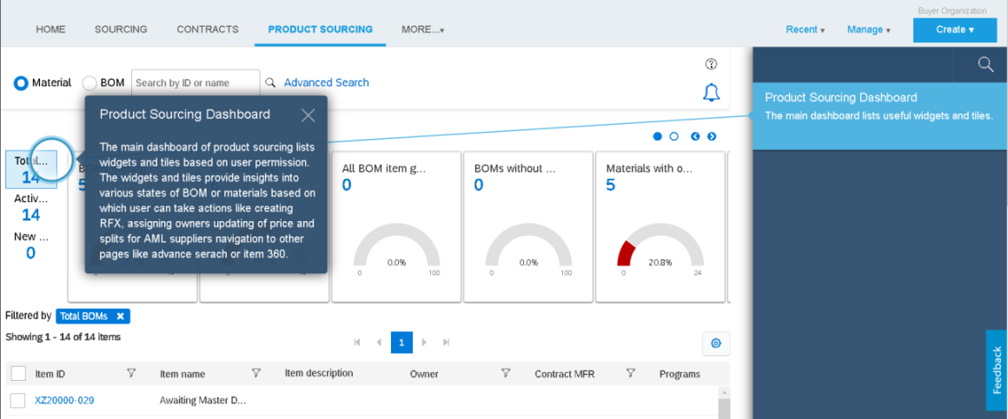
Sample SAP Ariba project: Product Sourcing The main page. Very few elements on each page.

Slide 16
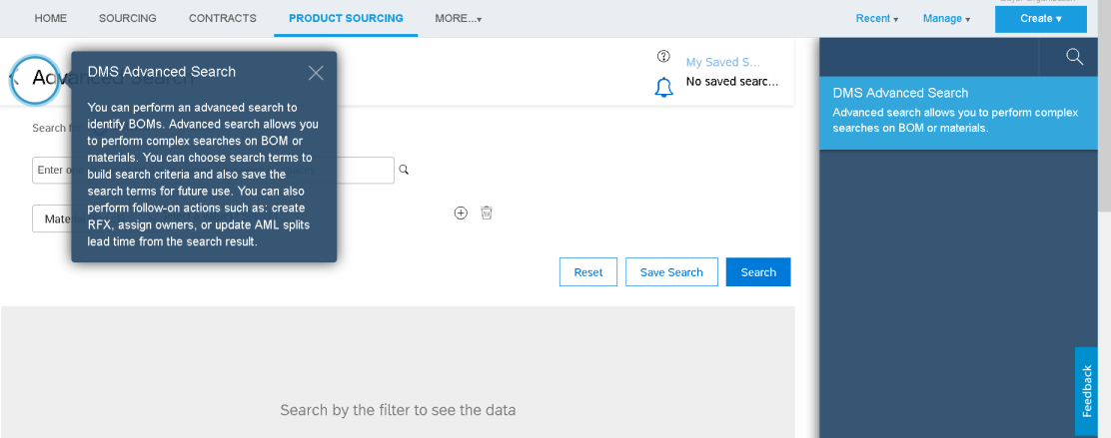
Sample SAP Ariba project: The advanced search page

Slide 17
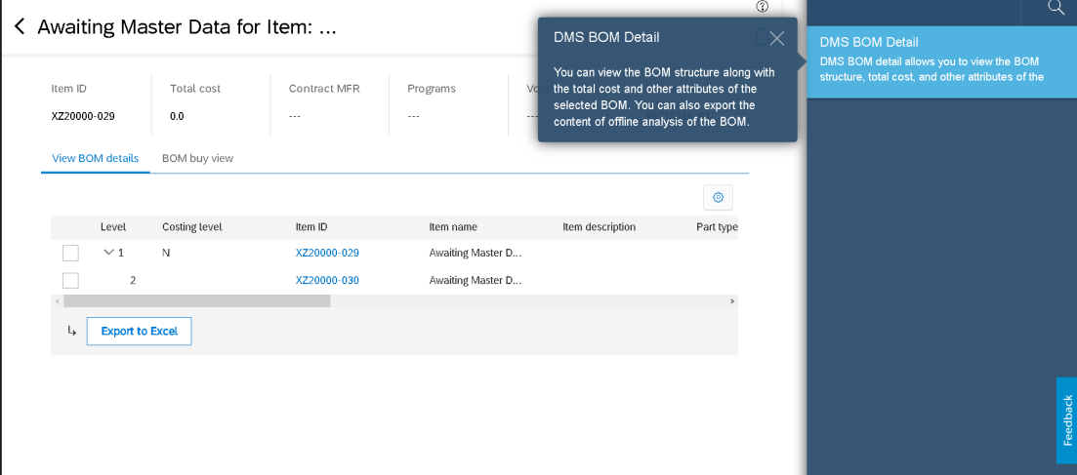
Sample SAP Ariba project : BOM details

Slide 18
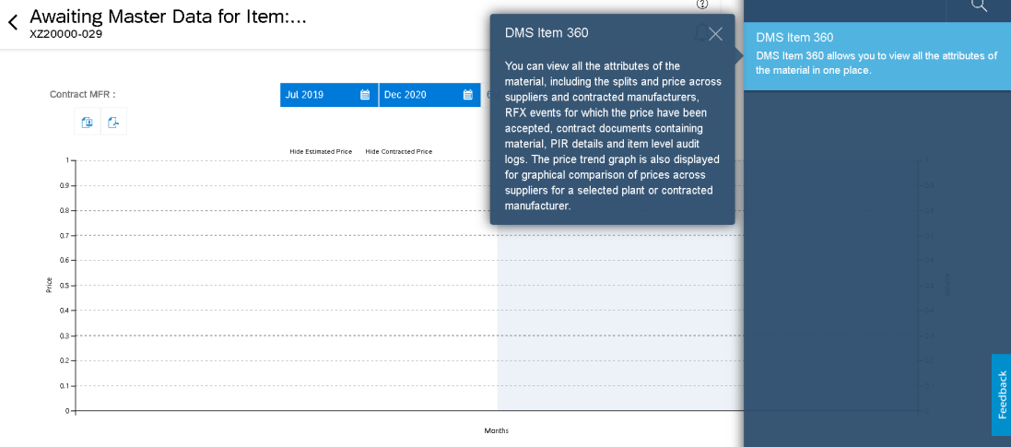
Sample SAP Ariba project: Item 360

Slide 19
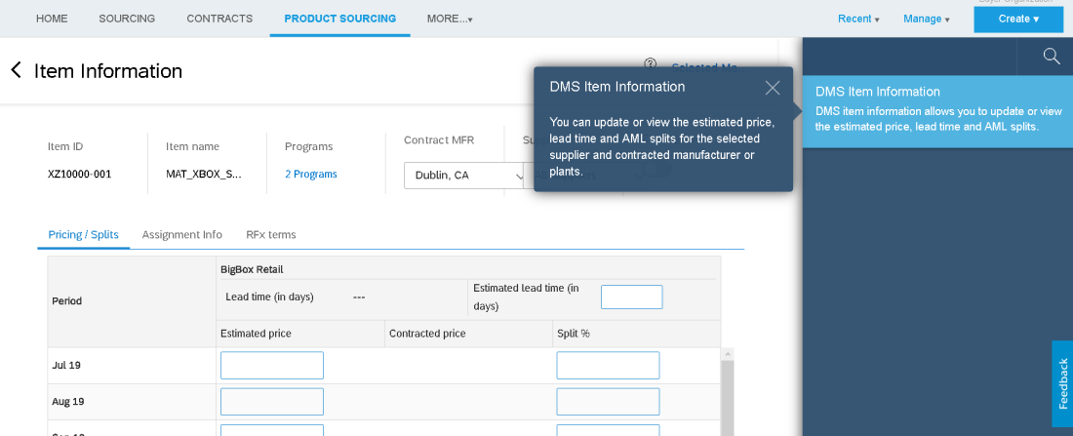
Sample SAP Ariba project: Item information

Slide 20
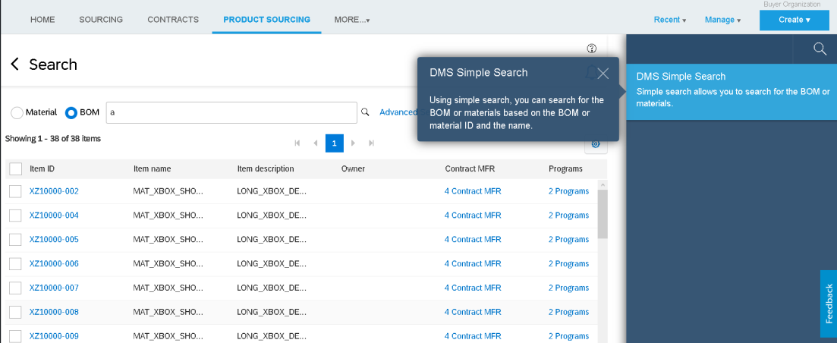
Sample SAP Ariba project: Simple search

Slide 21
Sample SAP project: Financial statement Very UI-driven content

Slide 22
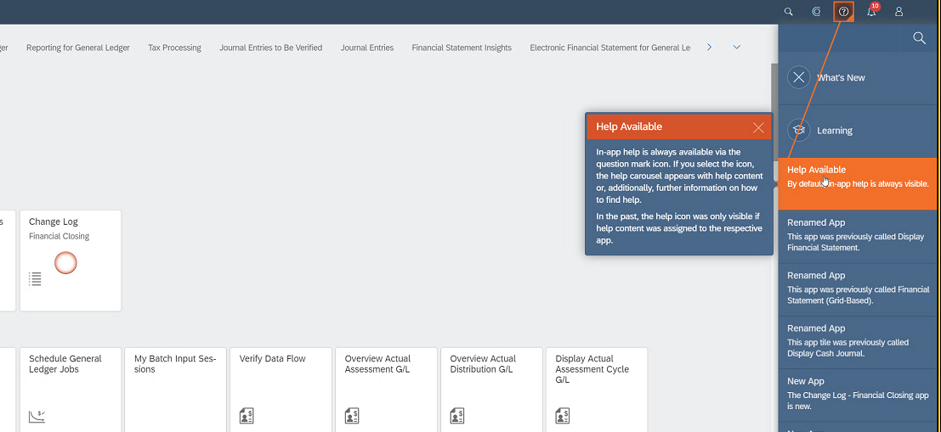
Sample SAP project: Financial statement What’s new info provided in the UI itself

Slide 23
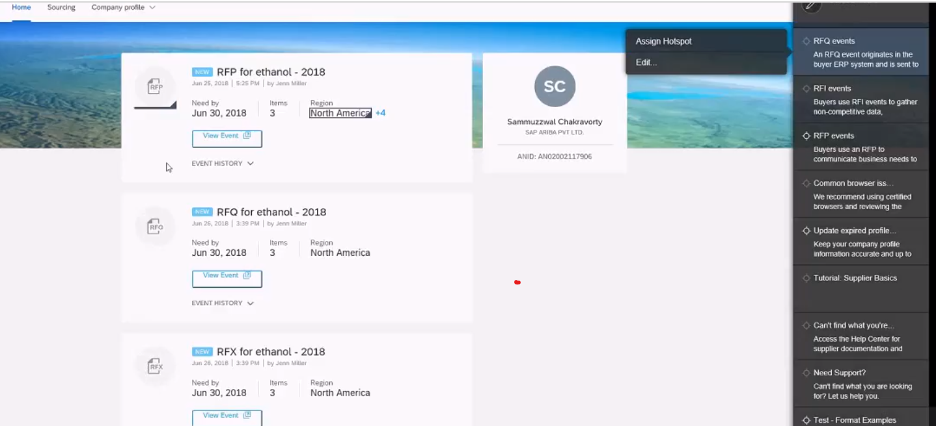
Sample Ariba Network project: Supplier Experience Help and guidance on the main page

Slide 24
Thank you.
Contact information:
Unnikrishnan G
Senior Manager, User Assistance
Prasad Hariharan
Senior User Assistance Developer

