Slide 1
Strengthen your User Assistance Role by being a Corporate Brand Ambassador
Roopa Ravikumar, SAP
Nidhi Prashant Augustine, SAP
Month 08, 2019

Slide 2
SAP Brand Ambassadors

Slide 3
Introduction: SAP Brand Ambassadors (APJ)
Roopa Ravikumar
Nidhi Prashant Augustine
As Brand Ambassadors, we are part of a select group of global employees responsible for inculcating the brand-first thinking and helping team(s) create seamless brand experiences in all that we do to help SAP reach our business goals.

Slide 4
Agenda
What is Branding?
Why is branding important?
Branding In Documentation
Insights and Learnings
Q&A

Slide 5
Branding Definition
Brand is NOT...
Only a logo, marketing, advertising, and communications
Brand is…..
What an organization stands for
Guiding all business decisions
Throughout the brand experience
To drive business growth

Slide 6
Importance of Branding
Brand is power and brand drives consumers…
Every organization has a brand strategy, all business decisions, stories, and experiences should align with the brand strategy.
A brand identity system is critical to develop a world-class brand.
The dynamic and unique visual system reinforces an organization’s identity, differentiates it from its competitors and conveys its commitment to be innovative.

Slide 7
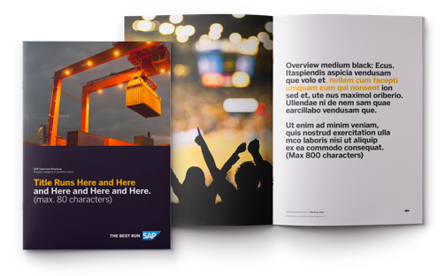
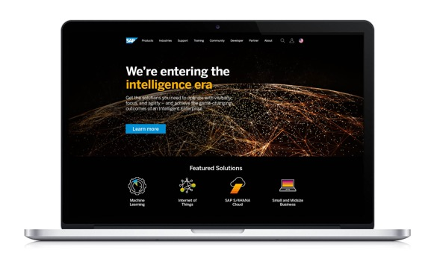
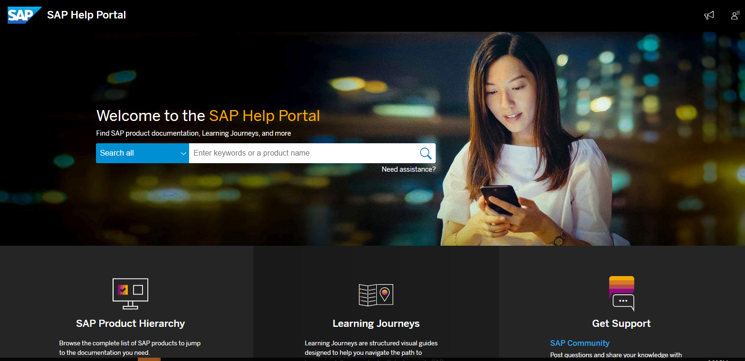
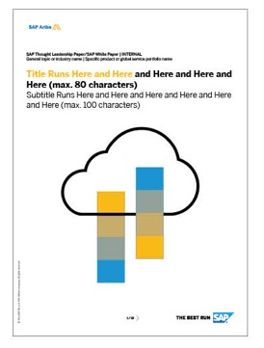
Consistent Visual Representation Differentiates Us….

Slide 8
“A brand is the set of expectation, stories, and relationships that taken together, account for a consumer’s decision to choose one product or service over another.”
Seth Godin

Slide 9
Branding in Documentation

Slide 10
Our tone of voice

Slide 11
Our tone of voice is how we sound
Clear
Insightful
Approachable
Optimistic
Straightforward
Conversational
Concise
Understandable
Illuminating
Helpful
Experienced
Smart
Engaging
Open
Inclusive
Authentic
Confident
Driven
Inspirational
Passionate
Notes:
Our tone of voice is how we sound. We speak in an open, engaging, human way. And how we communicate verbally is a big component of our interactions with customers. CIAO guides those verbal communications.
CIAO is an acronym that stands for the four ways we want to communicate: Clear, Insightful, Approachable, and Optimistic, and below each are explanatory words.

Slide 12
Branding is quintessential for writers!
Adhering to organization standards, style guide is paramount and irrevocable
Replicating the corporate website schema enhances branding
Engaging quality content/narratives enhances the eminence of the pool of skilled resources
Branding determines perception of your organization amongst your clients. All forms of content – video or text should resonate with the end user
‘Keeping it simple’ with crisp content, including contextual keywords, seamless navigation coupled with an invigorating digital experience enhances end user satisfaction

Slide 13
Branding Guidelines: Insights and Learnings
Visual Representation
Color Palette
Font
Graphics
Logo
Photography
Tone of Voice
Pictograms
Illustrations
Templates and Guidelines
Video guidelines
Newsletter templates
Power point and word templates
Social media guidelines
Naming guidelines

Slide 14
Our Contributions as Brand Ambassadors
Conducted interactive sessions and workshops on brand for multiple teams.
Sync up between Brand Ambassadors in the same location to share experiences and plan activities as a group.
Conducted Formal Brand Related Workshops as part of SAP Trainings.
Lead by example. Usage of branding guidelines with internal and external collaterals.
Presentations in external conferences.

Slide 15
Thank you.
Contact information:
Roopa Ravikumar & Nidhi Prashant Augustine
Roopa.Ravikumar@sap.com; n.Prashant.Augustine@sap.com
SAP Labs India, Bangalore

