Slide 1
Society for Technical Communication India Chapter
Welcomes you to the
Regional Conference at
SAP Labs India
Presented by
Nidhi Luharuwalla
President - STC India Chapter

Slide 2
Since 1999
STC INDIA CHAPTER
is affiliated with Society for Technical Communication
OUR GOALS
Create a forum to exchange ideas as well as share experience and knowledge
Bring technical communicators in various cities together
Educate the technical communicators in India through sessions, webinars, and conferences
Provide job opportunities
Recognize and award innovations in the technical communication field

Slide 3
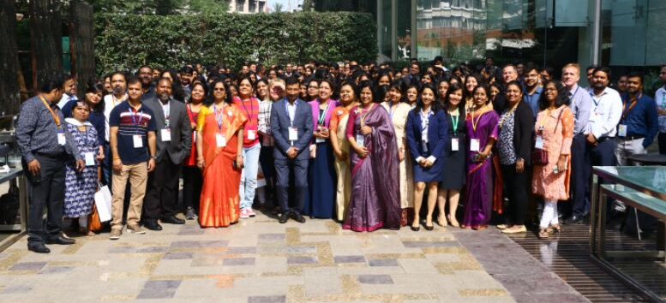
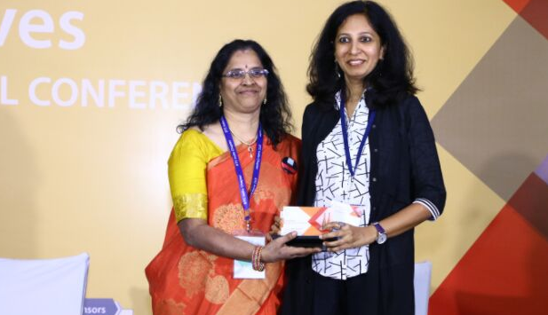
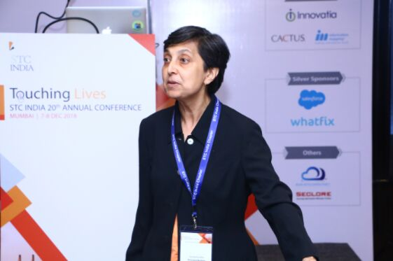
STC INDIA CHAPTER
ANNUAL CONFERENCES
STC India Chapter is conducting it’s 21st Annual Conference in Chennai from December 5 – 7, 2019

Slide 4
LEARNING SESSIONS
STC India Chapter conducts learning sessions across several cities in India – Bengaluru, Mumbai, Pune, Hyderabad, Chennai, Delhi NCR.
STC India Chapter Learning Sessions,
Regional Conferences, Webinars and Magazine
REGIONAL CONFERENCES
Every year at least one regional conference is held in each city.
WEBINARS
Participants who cannot attend the learning session can remotely attend the webinars.
INDUS MAGAZINE
A biannual magazine is published to showcase the innovation in technical communication field.

Slide 5
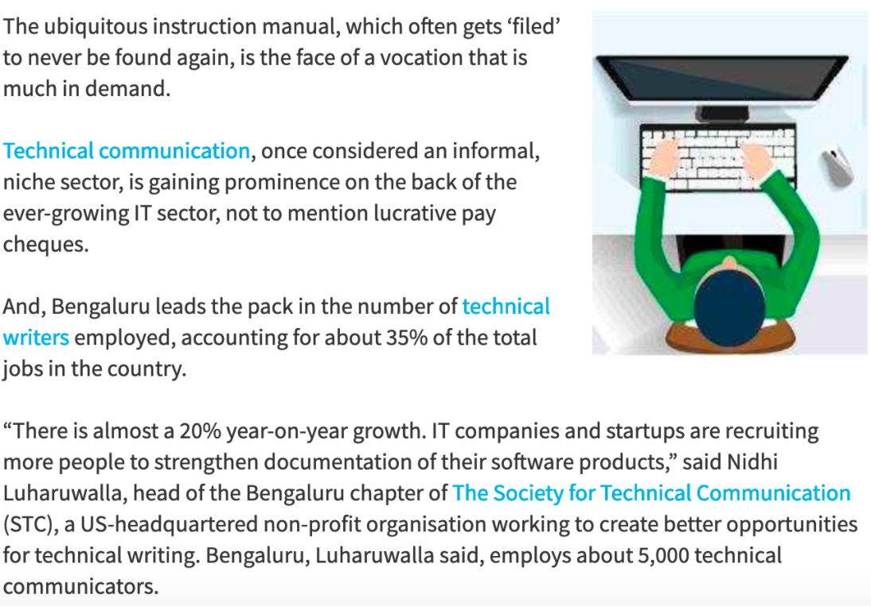
We got covered in the Ecomonic Times & other local media channels to create awareness about the technical communication Industry.

Slide 6
Want to be a part of STC India Chapter?
BENEFITS:
Attend STC events and webinars free or at a discount
Subscription to the Tech Comm magazine
Special price for the Annual Conference
Access the archived training materials
Attend the learning sessions, webinars and regional conferences without any registration charges
MEMBERSHIP MANAGER:
Raghuram Pandurangan
Email: membershipmanager@stcindia.org

Slide 7
A Big Thank You to
Our Sponsor Partner
Your immense support made it possible

Slide 8
BE INSPIRED:
When you learn, teach. When you get, give.
-Maya Angelou

