Slide 1
MINIMAL VIABLE PRODUCT Your solution's first step into the market
Nithya Krishnan, SAP LABS INDIA
August, 2019

Slide 2
A little about myself
I’m Nithya and I’ve been into the stream of technical communications/writing for about 13 years.
SAP has been my home turf for more than a decade
I love writing and designing. I enjoy talking about some parts of my writing to a wider audience
I believe the best ideas come from sharing and learning. Let’s get started then, shall we?

Slide 3
Agenda
What is a Minimal Viable Product (MVP) ?
Key attributes and benefits of MVP
Process steps to consider
What does it mean for technical writers?
Examples of MVP in the market

Slide 4
What is a Minimal Viable Product?

Slide 5
Some history to this..
Back in 2011, Eric Ries who is an American entrepreneur, blogger, and author, released his bestselling book The Lean Startup about his experience in building startups.
This book not only impacted the whole startup industry, but also introduced concepts including MVP, A/B testing, Agile principles, and continuous software deployment.

Slide 6
What does MVP represent?
Minimum
Viable
Isolated functions that cannot be consumed
Well-thought of functions that can be consumed
A stable product with the right features that users want
Notes:
MVP is a means to test the product that you are going to be launching in the market. It should be understood that MVP does not mean an unfinished product rather it is a way to get feedback for the final product. Let’s break down the term MVP for better understanding.
Minimum means a product that has simple features and usually, no users want to use or buy it. Viable is the product that a developer dreams of creating with the help of available resources to fulfill the needs of users. So the term MVP means a way to build such a product that has all the features and at the same time, has used fewer resources. It also should be able to get honest feedback which is how the final product will be developed.
The idea of minimum viable test does not mean to see if the product can be technically improved or not. MVP shows whether a product should be built in the first place or should not be built at all.

Slide 7
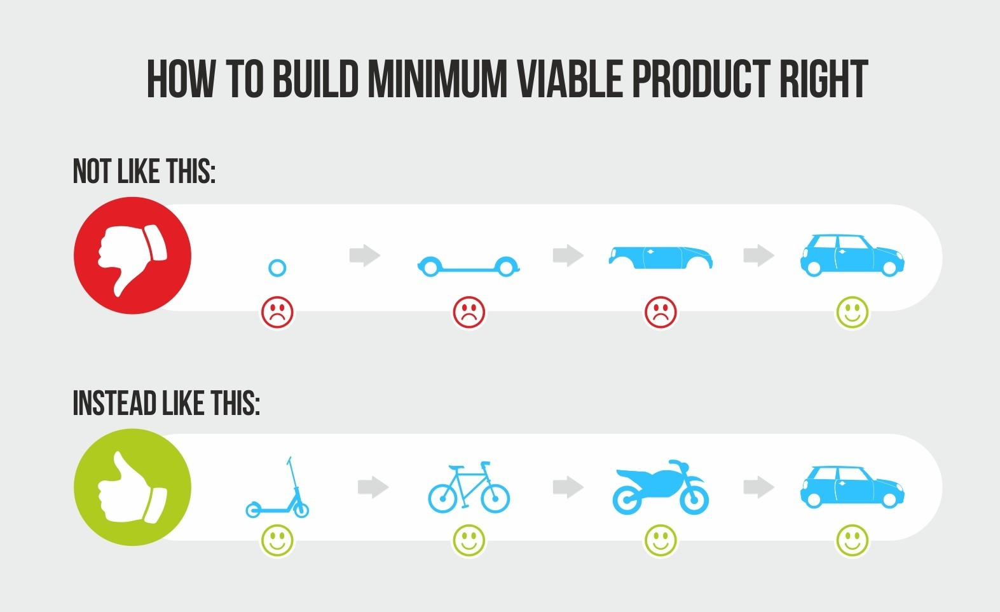
To put it all together..
Minimum Viable Product or MVP is a development technique in which a new product is introduced in the market with basic features, but enough to get the attention of the consumers. The final product is released in the market only after getting feedback from the product's initial users. MVPs can help you avoid failures and large capital losses.

Slide 8
Key attributes of MVP
Must Sell
MVP is not MVP until it sells
It must carry enough value to the users
Build Core Features
Not a product with the minimum number of elements
Has core features sufficient to implement an idea and retain early adopters
Iterative Process
Based on the lean startup philosophy
Iterative process of the building-> measuring-> learning loop until the product meets the market need completely
Avoids huge development efforts
Aims to avoid building unconsumable, unnecessary products
Gain insight about the market first

Slide 9
Process steps involved
Market study
Analysis of potential competitors
Key Features
Defining and prioritizing features
Uniqueness
How different is your solution from the rest
Minimal +Viable
Define the scope
Stakeholders
Review
Product vision
Identify the people involved
Get constant feedback
Notes:
PERFORM AN INITIAL MARKET STUDY
Before dwelling into the execution of the idea, find the potential your product has or might have in the existing market. You should talk to users, search for similar kind of products, and look for potential competitors. There might be a probability that you might have the same idea as someone else in the market. Given the existence of so many people in the world, some ideas are bound to be redundant. Although redundant ideas are not an issue, their potential or feasibility needs to be looked into.
LIST THE FEATURES YOU ENVISION FOR YOUR PRODUCT/APPLICATION – Without any hesitation, you need to use your unfettered mind to list all the features of your product. This step is essentially ideal to be done before you start looking for the right partners to develop your idea. Although you will focus on the MVP, it’s nice to share the list of features and see how they respond to them, so you can measure their level of confidence not only going over the MVP, but kind of feeling what they think about the whole product.
DEFINE THE UNIQUENESS OF YOUR PRODUCT – The main goal is to develop a product that will attract customers who will eventually use it because of certain things that make it different from the rest. Knowing what makes your app unique from day one will help out focusing efforts (time and money) from the very first moment.
SEPARATE CORE FEATURES AND ADD-ONS – Separate the list into most important features and features that can be done as add-ons after the MVP launch. This step seems very straightforward, but sometimes feelings and dreams can be a trap and you will end up with a big set of features for the MVP. Review it as much as you can until you come up with a filtered and ordered list based on your knowledge about market priorities and requisites.
LOOK FOR THE RIGHT PARTNER TO DEVELOP MVP – You need to look for the right partner to develop MVP based on these factors – Communication, Decision Support, Design, and Full Stack Engineering.

Slide 10
Build. Measure. Learn
The key contributor is the iterative loop of improving the product continuously.
Once you have your first version, it is important to understand that users give you feedback.
With this review, you can start improving your product, by following the process iteratively; test, learn, and measure the quality, and then test again, and the process goes on until it is finalized.
Measure
Learn
Build

Slide 11
Key benefits of MVP
Possibility to attract investors early
Reduction of potentially wasted engineering hours
Gaining and expanding the user base
Learning and Education
Checking real-life market tendencies
Avoidance of the bigger failures and fund expense

Slide 12
What does this mean for technical writers and how can you contribute?
Right use of terminology for your product
Convincing user stories
Tutorials or demos
Interactive guided tours using storyboarding
Videos of anticipated behavior

Slide 13
“We must learn what customers really want, not what they say they want or what we think they should want.”
Eric Ries

Slide 14
“As you consider building your own minimum viable product, let this simple rule suffice: remove any feature, process, or effort that does not contribute directly to the learning you seek.”
Eric Ries

Slide 15
MVP stories that created a huge hit in the market
Shortly after moving to San Francisco in October 2007, two former schoolmates could not afford the rent for their loft apartment.
They came up with the idea of putting an air mattress in their living room and turning it into a bed and breakfast.
The goal at first was just “to make a few bucks”, as they said in interviews.
So, the SF company chose to target the audience of Craigslist.
They put together a website, but they kept struggling to find people to use their platform.
They then realized that matching bed and breakfasts with customers could be a goldmine.
The rest is history. Today, this company has a yearly income of ~$3billion (2017).
By providing an option for homeowners to automatically post to Craigslist, this company reached lots and lots of prospective users.

Slide 16
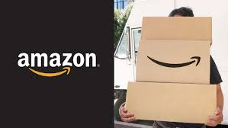
MVP stories that created a huge hit in the market
In the beginning of the 1990s, he read a report about the future of the internet that projected annual web commerce growth at 2,300%.
He created a list of twenty products that could be marketed online and later narrowed the list to what he felt were the five most promising products.
This included compact discs, computer hardware, computer software, videos, and books.
The website was very simple with just a catalogue of books. If a customer ordered one, the company bought it straight from the distributor and shipped it.
Hence, this company was founded in his garage at his rented home in Bellevue, Washington.
He finally decided that his new business would sell books online, due to the large worldwide demand for literature, low price points for books, as well as the huge number of titles available in print.
Iteration after iteration followed.
Over the years, this company started to sell more products, bought warehouses, and personalized their website for each visitor.

Slide 17
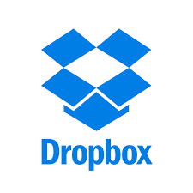
Some of the biggies that used the MVP process

Slide 18
Thank you.
Contact information:
NITHYA KRISHNAN
Senior User Assistance Developer | User Experience Advocate
https://www.linkedin.com/in/nithyakrishnan/

