Slide 1
Humanizing User Interface
Amrita Pavangad (User Assistance Developer)
Anju Jose (Senior User Assistance Developer), SAP Labs
August 31, 2019

Slide 2
Agenda
What is humanized content?
Tailor content to the required users
Create intuitive content
Why we need personalize content?
People respond to people
People develop a connect with the brand
How can we create humanized content?
Engage with the audience
Get involved in all stages of product development

Slide 3
What is humanized content?

Slide 4
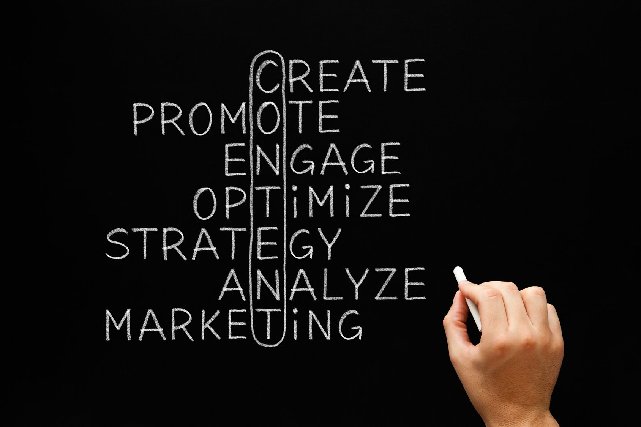
What is humanized content?
“Content is king, but engagement is queen, and the lady rules the house!” – Mari Smith, social media master
Tailoring content to the required users
Appropriate choice of words
Appropriate language and tone
Intuitive content
Encourages user to take an action
Consistent and continuous

Slide 5
Why should we humanize content?

Slide 6
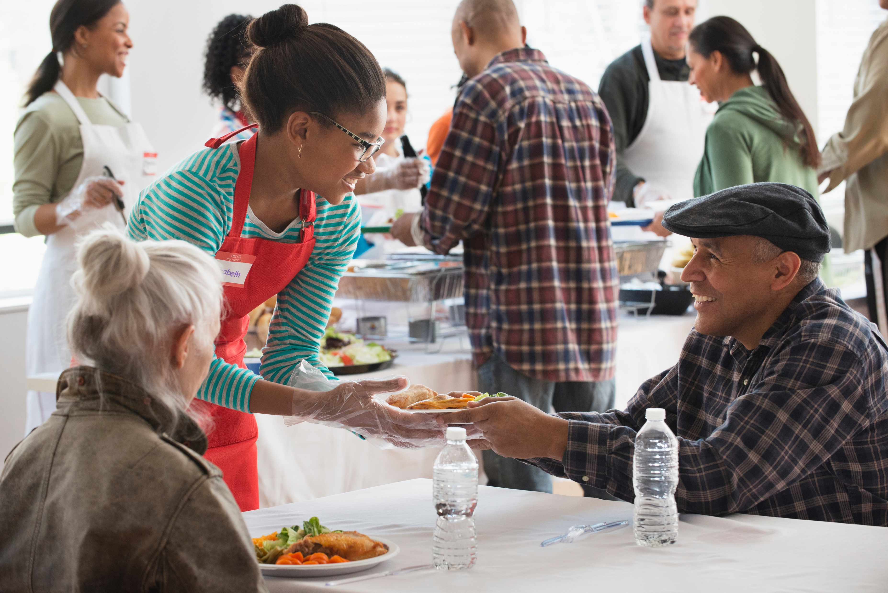
People respond to people
We live in a noisy world. Nowadays to stand out as a brand you either have to offer an unparalleled customer experience or become a really engaging storyteller. Or both.
- Ekaterina Walter
People are more concerned about how their specific problem can be solved: focus on this taking a people-centric approach
People develop a connect with the brand

Slide 7
How can we create humanized content?

Slide 8
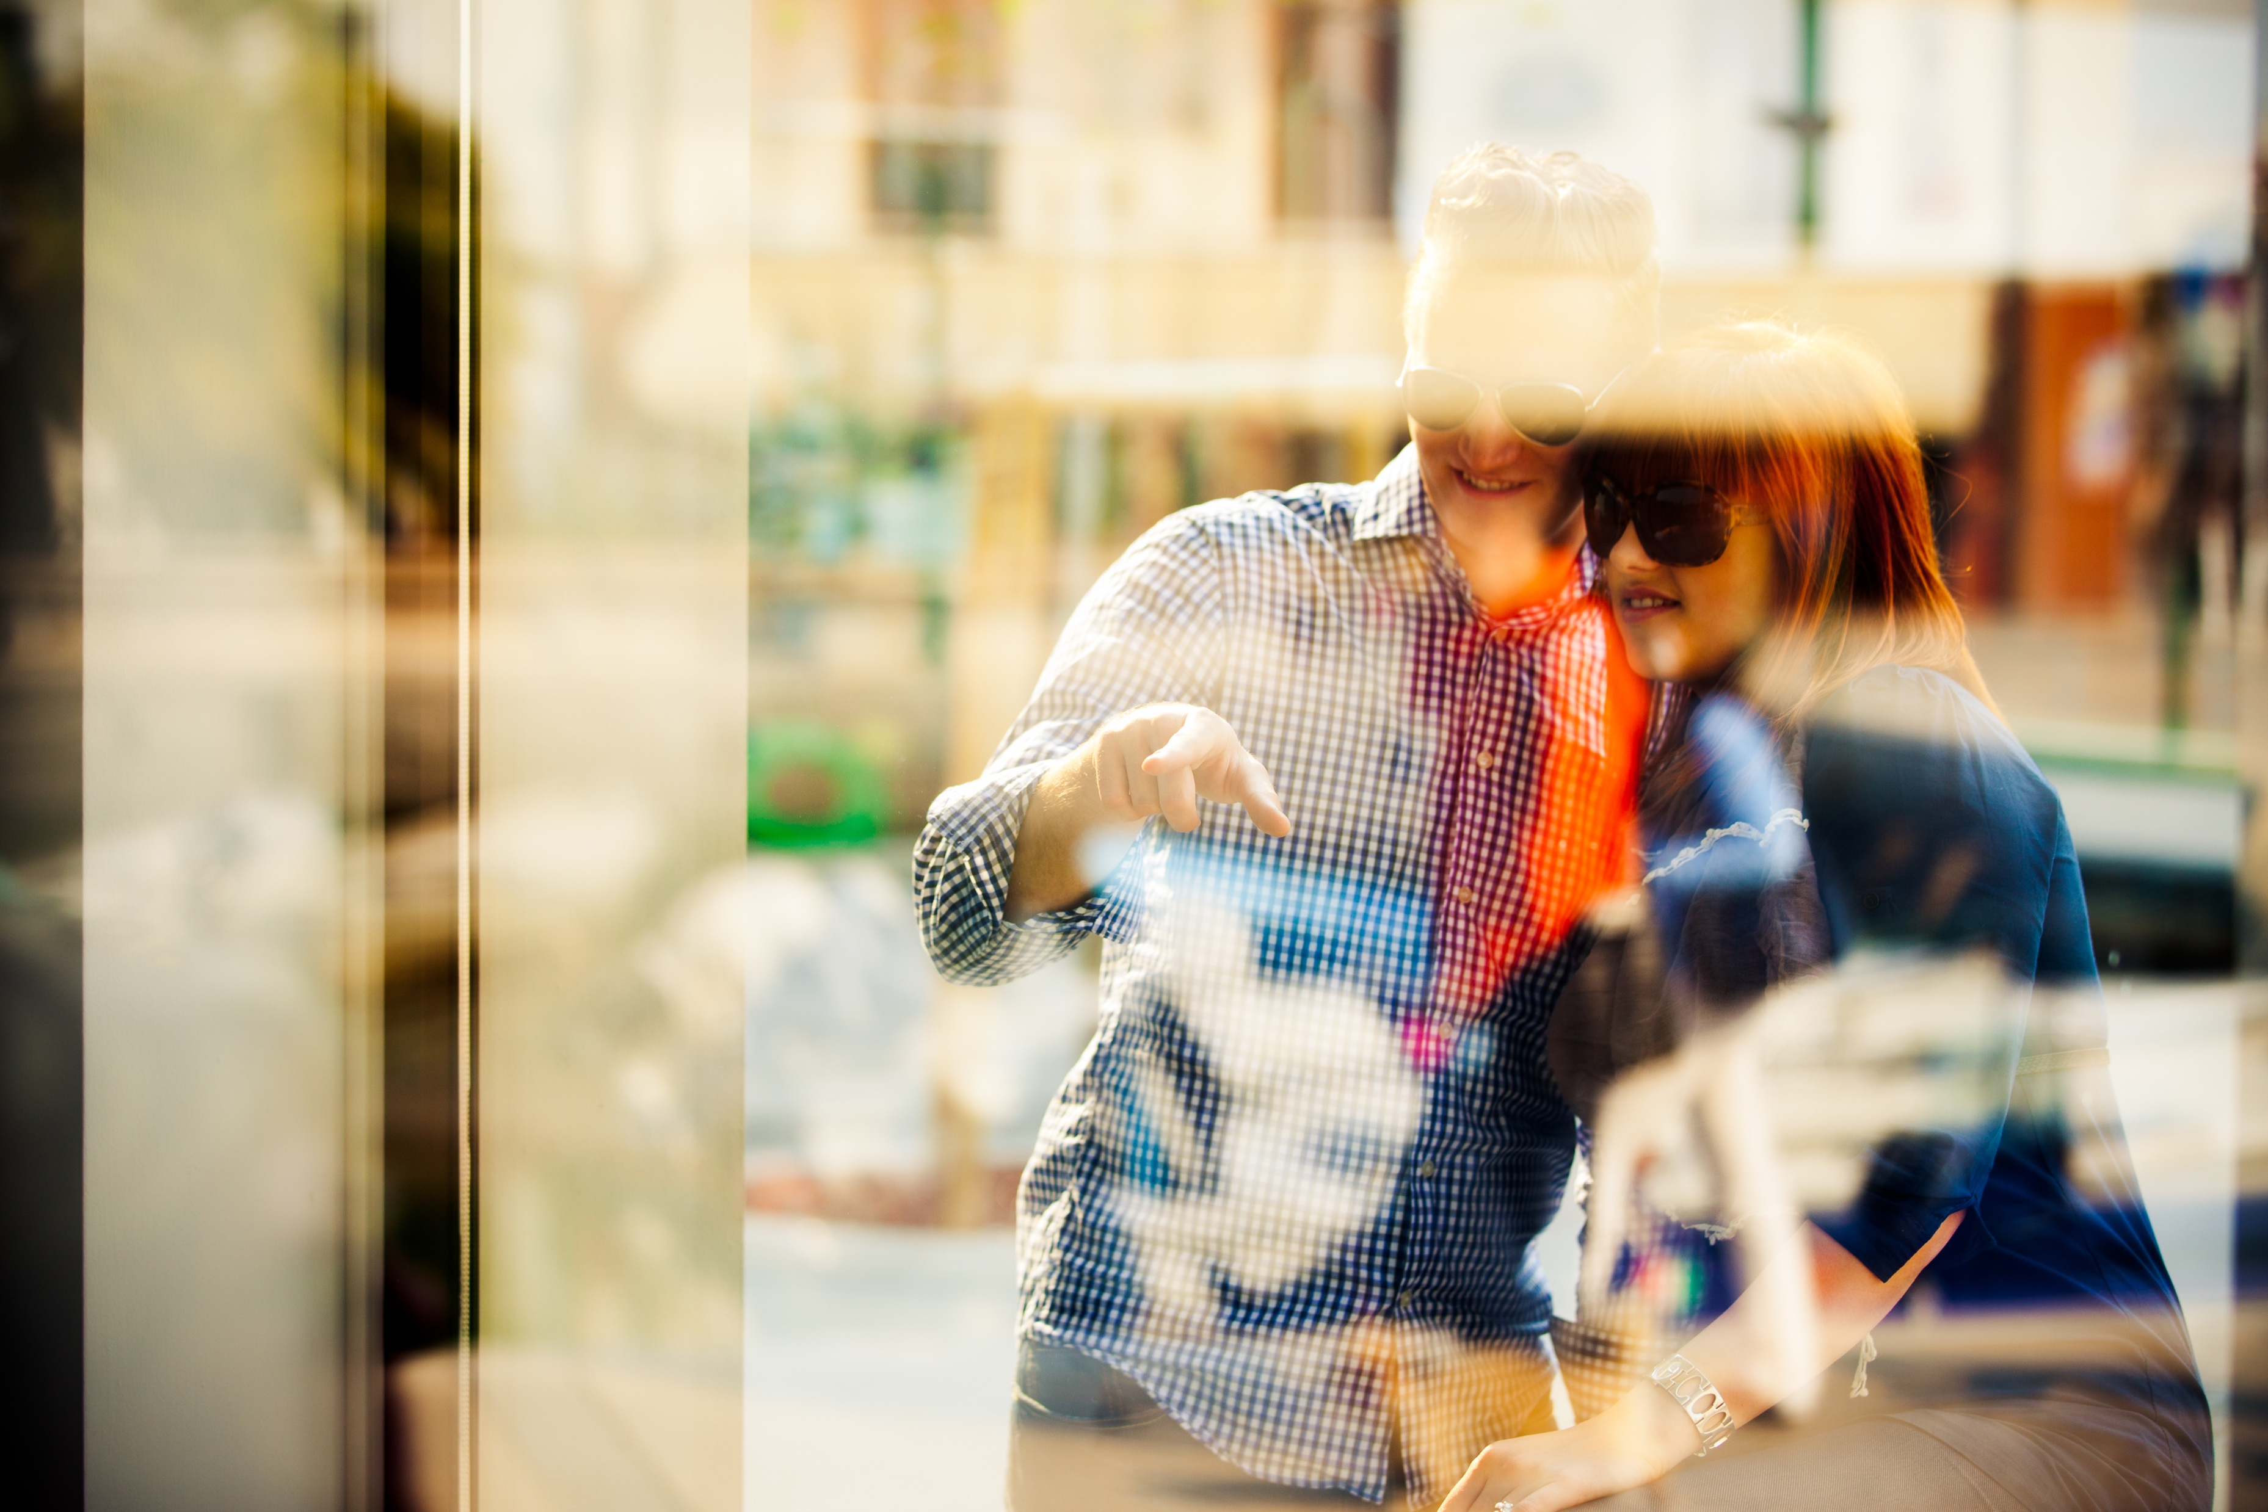
Involve in all stages of product development
Engage with your audience
Be transparent
Focus on relationships
Remember that customers are people

Slide 9
Thank you.
Contact information:
Amrita Pavangad: amrita.pavangad@sap.com
Anju Jose: an.jose@sap.com

