Slide 1
Do a Little Something More: Unify Heuristics and Usability Testing
Aishwarya Bettadkurli Rajesh
Soumyavathi Venkatesh
Team User Assistance, Analytics UX/UA IND
August 31, 2019

Slide 2
Agenda
Introduction
UA Involvement in the Product Journey
Heuristics of UI Design
UA Heuristics with Examples
Usability Testing – A User Assistance Perspective
The Key Take-Aways

Slide 3
“You have just 5 minutes to impress a new user.” SAP Customer Success
“40-60% of users who sign up for a free trial of your software or SaaS application will use it once and never come back.”
Patrick McKenzie, SAAS Marketing & Consulting
“5% increase in user retention can increase the value of a business by more than 25%.” Harvard Business Review

Slide 5
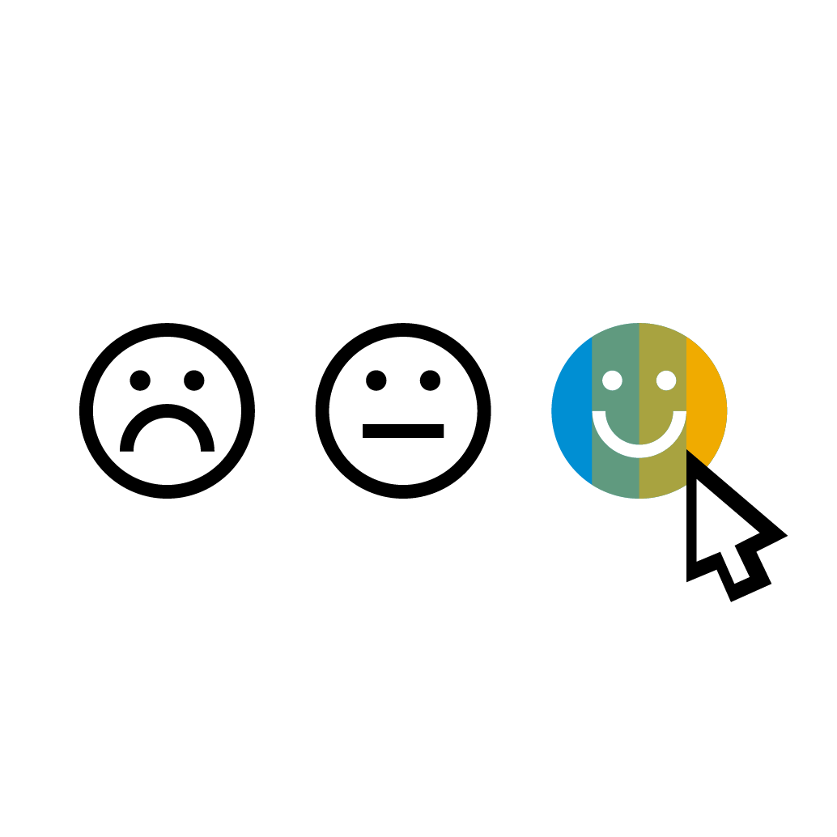
UA involvement in product journey
Requirement Gathering & Design Phase
User Experience
Product Development Phase
Product Shipment
Customers (First Time Users + Long-term Customers)
QA Functional Testing + UA Usability Testing

Slide 6
Heuristics
Visibility of System Status
Error Prevention
User Control & Freedom
Help & Doc
Flexibility & Efficiency of use
Error Recovery
Recognition Rather Than Recall
Match between System & Real World
Consistency and Standards
Aesthetic & Minimalistic Design
Heuristics of UI design

Slide 7
Visibility of System Status
Don’t blindfold your users!

Slide 8
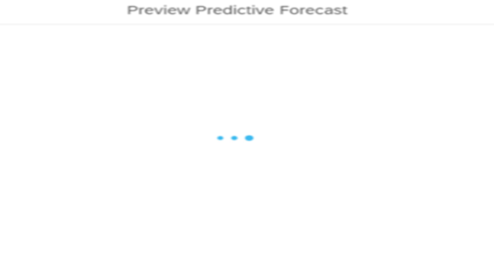
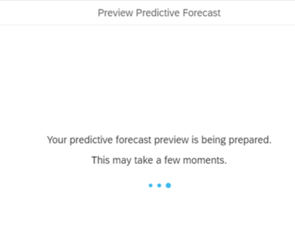
Visibility of system status
System Status
Confirmation
The last saved version of the tile was pinned home successfully.
Nicely done! We’ve pinned the latest version of the tile to your Home page.

Slide 9
ERROR PREVENTION
Prevent your users from making mistakes.

Slide 10
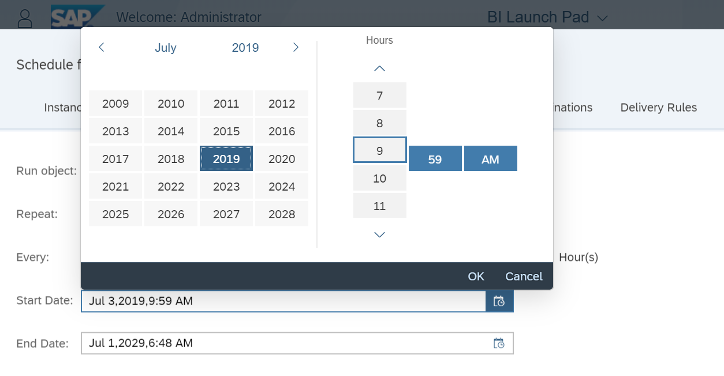
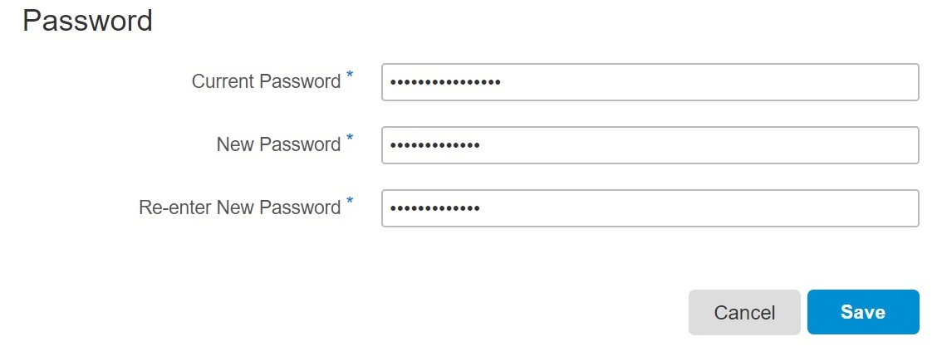
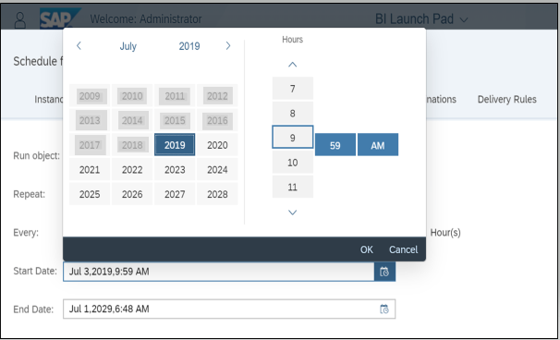
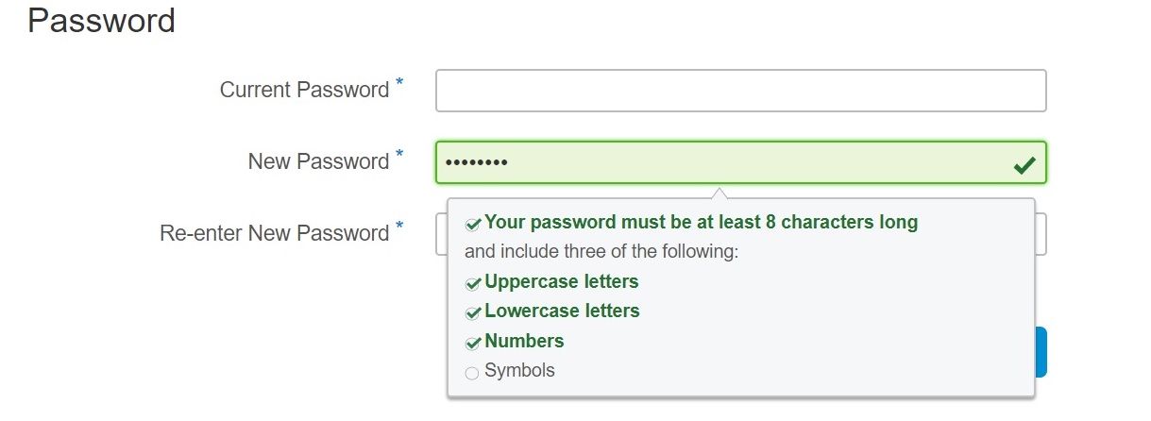
Error prevention
Constraints
Suggestions
Warnings

Slide 11
Flexibility & Efficiency of Use
Satisfy newbies and experts.

Slide 12
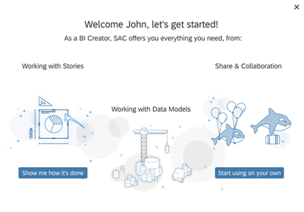
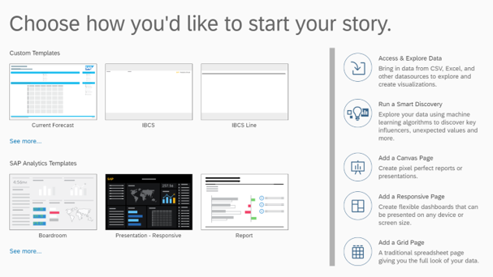
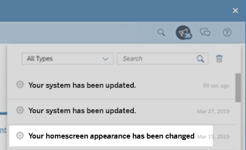
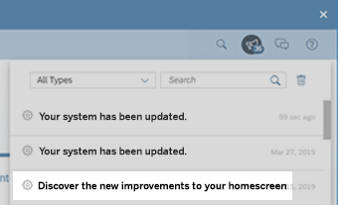
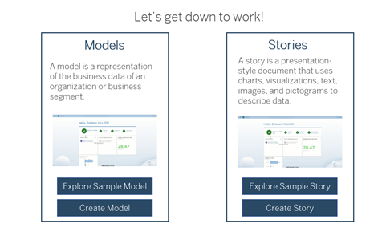
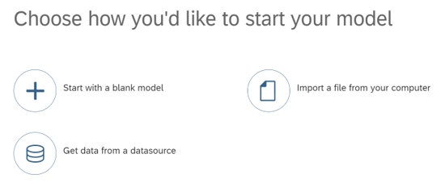
Flexibility & efficiency of use
Onboarding
In-App Guidance
Managing Change

Slide 13
Error Recovery
Help your users recover from errors to build a great relationship.

Slide 14
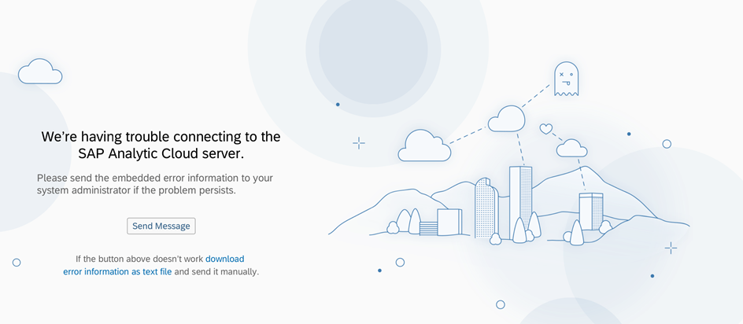
Error Recovery
Recognize
Diagnose
Recover

Slide 15
Match between the System & the Real World
Speak to your user like a human.

Slide 16
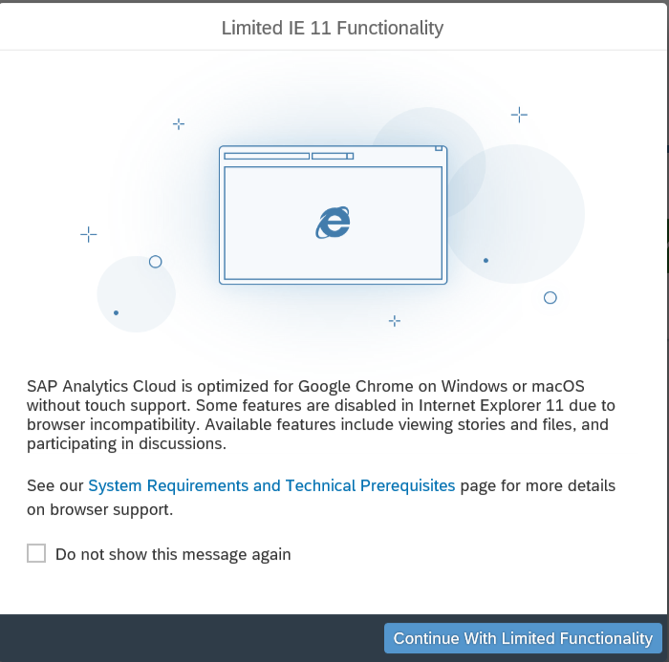
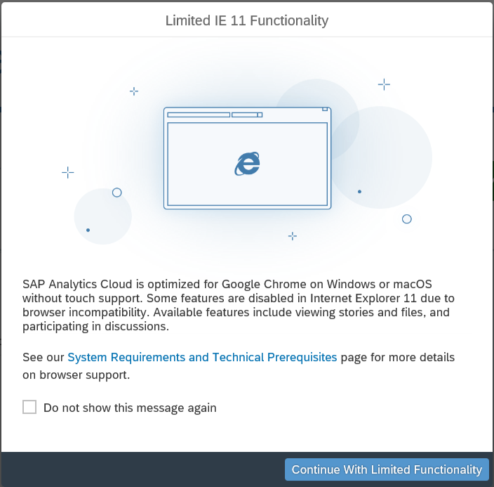
Match between the system & the real world
Explain Things & Use Familiar Language
We noticed you’re using Internet Explorer 11…
Not a problem! But for the moment our app works much better on Google Chrome (on both Windows and macOS)... We’re working on it!
You can still use the app on Internet Explorer, but some cool features won't be available.
More…
Please don’t show this again.
Continue with IE
Close and login with Chrome

Slide 17
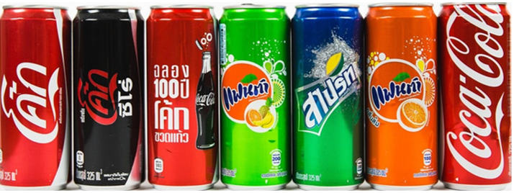
Consistency & Standards
Build Loyalty & Trust.

Slide 18
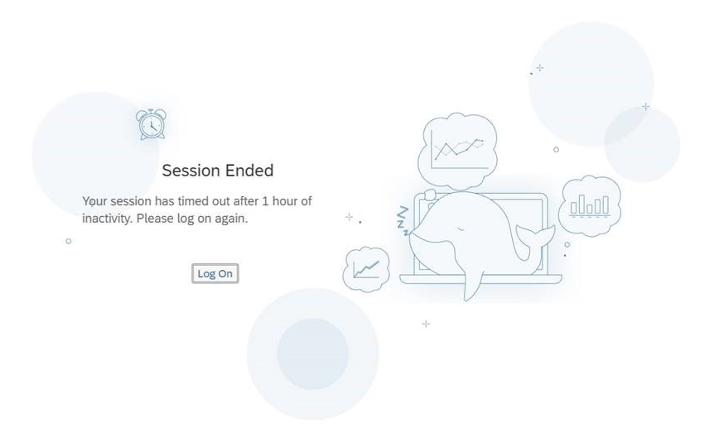
Consistency & standards

Slide 19
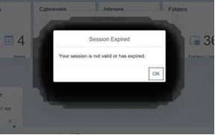
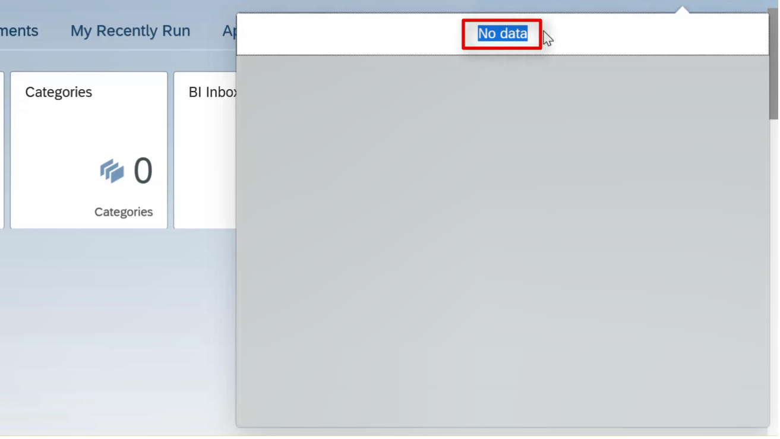
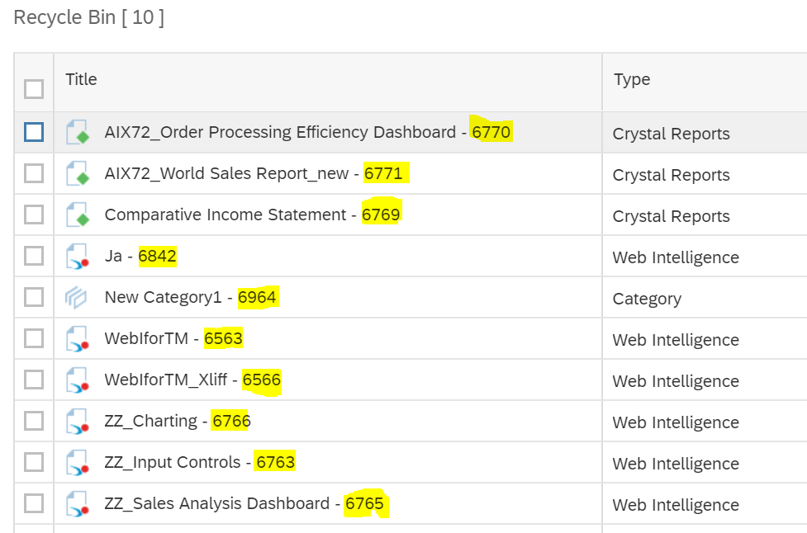
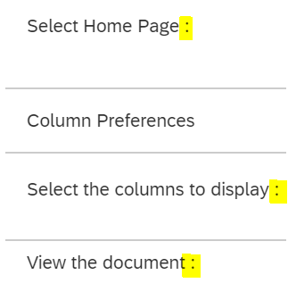
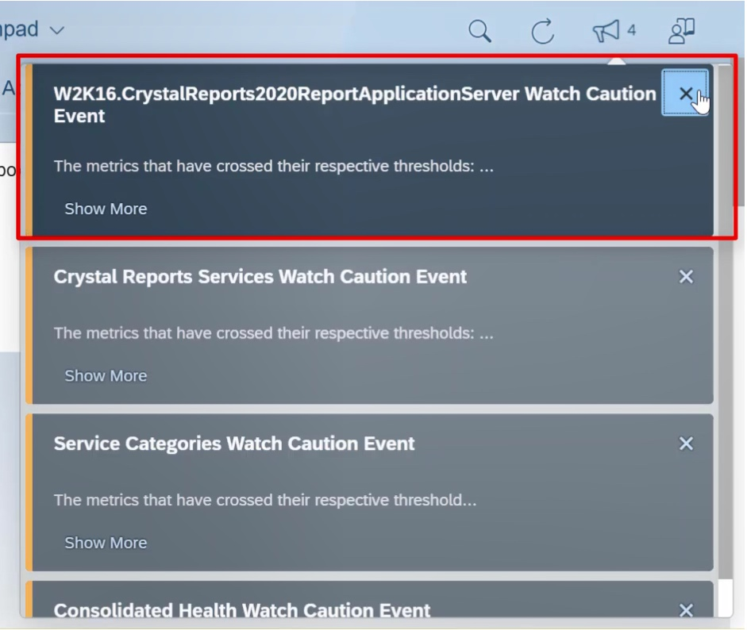
Usability testing- UA perspective
Aesthetic & Minimalist Design
Speak in Your User’s Language
Grammar and Punctuation
Efficiency of Use

Slide 20
The key take-aways
As a technical communicator, involving the concept of Usability Testing in the product journey will result in user-friendly, feasible product.
UA Heuristics is one such key factor to look into during the testing and the review phase.
Visibility of System Status: Engaging System Status, Confirmation & Error Handling
Error Prevention: Provide proper Constraints, Suggestions, and Warnings
Flexibility & Efficiency of use: A good On-Boarding process, informing new changes, & In-App Guidance.
Error Recovery: Optimal ways of Recognizing, Diagnosing, and Recovering from the errors.
Match Between the System & the Real World: Prefer familiar language than mere technical jargons.
Consistency and Standards: Use your Brand Voice to convey any information.
Other factors such as Aesthetic & Minimalistic Design, Grammar & Punctuation, Efficiency of Use will enhance the acceptance of the product.

Slide 21
“Explore, Enrich, Empower.”
Any Questions
?

Slide 22
Thank you.
Contact Information:
Aishwarya Bettadkurli Rajesh
Soumyavathi Venkatesh
Team User Assistance,
Analytics UX/UA IND,
SAP Labs India Pvt. Ltd, 560066

