Slide 1
Content Marketing and TechComm Future of content-merging technical and marketing content
Sadhana S
Information Developer at IBM, Blogger
www.linkedin.com/in/sadhana-s
https://sadhanainspiresyou.com/
sadhana.technicalwriter@gmail.com
Confidential

Slide 2
Objective
By the end of this session, you will learn:
What is Marketing content
Crossing paths-TechComm and marketing content
Future of content-Technical content serves as marketing weapon
Unified customer experience
Hone your skills to author for marketing content
Benefits-TechComm + Marketing content
Key Takeaways

Slide 3
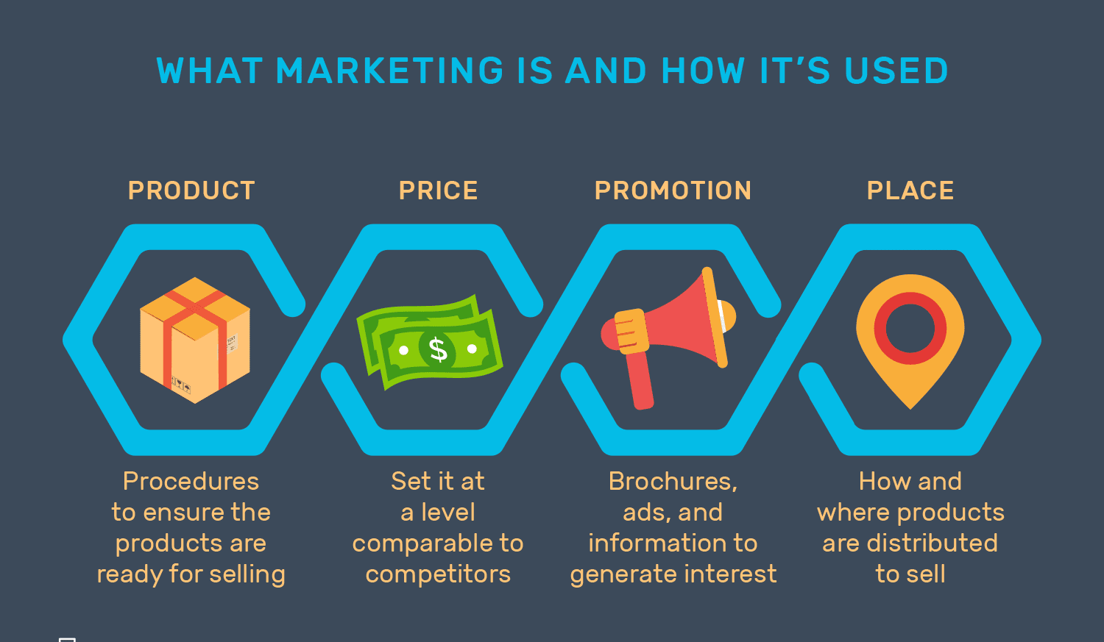
Marketing Content, What is it?
Content like videos, blogs, social media posts that fuels interest for customers in a business product and services refers to marketing content.
Promotes brand.
Calls for customer action.
Confidential

Slide 4
TechComm And Marketing Content-Crossing Paths
Technical content
Marketing content
Addresses use case and why factor in technical docs.
Target Personas.
Prospect users are turning to technical docs as reference prior to product purchase.
No more centered only to brand promotion.
Target Personas.
Focus on building customer trustworthiness with upfront technical content.
Confidential

Slide 5
Future of Content-Technical Content as Marketing Weapon
Pre-purchase reference content.
Addresses why, what, how, and benefits of a feature.
Sets product expectation clear to the customers.
Reflects company’s technical support and after-sales experience.

Slide 6
Unified Customer Experience
Customer Engagement
Marketing Content
Technical Content
“Content Silo Trap”.
Gartner research-90% organizations do not have a formal content strategy to achieve unified experience.
Collaboration of TechComm and Marketing teams.
Content generated from a single source.
Build audience before product is out in the market.
Improves customer journey with content.

Slide 7
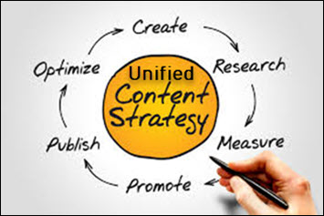
Hone Skills To Author Marketing Content + Technical Content
Unified content strategy.
Content repository, content reuse.
Target Persona content.
Storytelling, Blogs.
SEO friendly content.
Call to Action (CTA).
https://blogs.cisco.com/security/apple-cisco-ibm-next-level-mobile-security
https://blog.zimperium.com/zimperium-integrates-ibm-maas360-watson/

Slide 8
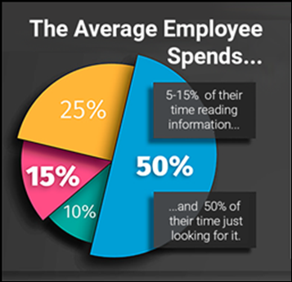
Significant Benefits - TechComm + Marketing Content

Slide 9
Key Takeaways
Marketing content pitch.
Technical content - marketing weapon for an organization.
Content silo trap.
Merging technical and marketing content.
Unified customer experience.
Unified content strategy.
Tips and Tricks to serve technical content as marketing content.
Maximize ROI.

Slide 10
Thank You
Sadhana S
Information Developer, Blogger
www.linkedin.com/in/sadhana-s
https://sadhanainspiresyou.com
sadhana.technicalwriter@gmail.com

